Slide 1
Python - Capstone Project
Presented by
V.Lakshmi Sireesha

Slide 2
The OTP Verification System
Project Requirements
In this Project we were asked to
Implement a function to generate a 6-digit OTP randomly.
Develop a function to simulate sending the OTP to the user's email address.
Create a function to prompt the user to enter the OTP received in their email.
Implement a function to verify if the entered OTP matches the generated OTP.
Ensure proper error handling and user-friendly prompts throughout the system.
Allow the user to retry OTP entry in case of incorrect input.
Python Script/ code : Provided in the separate file

Slide 3
Functions Used
randint() function from the Random Module
generate_otp()
send_otp_to_email()
prompt_user_for_otp()
verify_otp()
main()

Slide 4

randint() function
Import the random module to generate a random number (OTP). The OTP will be a 6-digit number, so we use the randint() function to generate it.
generate_otp()
This function generates a 6-digit random number using random.randint(100000, 999999).
The randint() function returns a random integer between 100000 and 999999 (inclusive),
The number is then converted to a string using str() so that it can be easily printed and handled as text later.

Slide 5
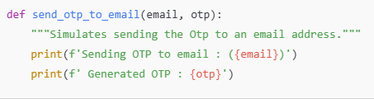
send_otp_to_email()
This function simulates sending the OTP to the user's email.
here it just prints out the OTP and email address for testing purposes.
Parameters: It takes in two arguments:
email: The email address where the OTP will be sent.
otp: The OTP that is to be sent.
Output: This prints two things:
The email address to which the OTP is being sent.
The generated OTP itself

Slide 6


prompt_user_for_otp()
This function prompts the user to enter the OTP they received in their email.
This will print a message asking the user to input the OTP and then return whatever the user types as a string.

Slide 7
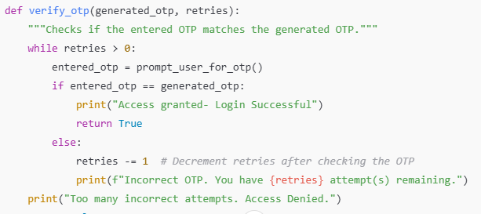
verify_otp() function:
This function verifies if the OTP entered by the user matches the generated OTP. If the entered OTP is incorrect, it allows the user to retry (up to 3 times).
Parameters:
generated_otp: The OTP that was generated and should be matched with the user's input.
retries: The number of remaining attempts the user has to enter the correct OTP.

Slide 8
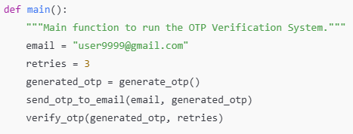
main () function
This is the main function that runs the OTP verification system
It sets a sample email user9999@gmail.com and the number of allowed retries as 3.
It generates a random OTP by calling generate_otp().It sends the OTP to the user’s email by calling send_otp_to_email().
Finally, it calls verify_otp() to start the process of verifying the user-entered OTP.

Slide 9


Test case 1: Valid OTP Entry
Random OTP Generation and prompting user to enter the OTP
Entering the right OTP and Getting successful Access to Login

Slide 10

Test case2 : Invalid OTP on First Attempt
Entering an invalid OTP and getting prompted by the system as incorrect and no .of attempts left

Slide 11
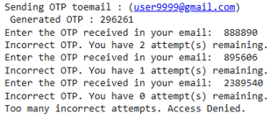
Test Case 3: Multiple Incorrect OTP Attempts (All Fail):
Making multiple(3) incorrect OTP entries and failing to get access

Slide 12
Conclusion
In conclusion, The OTP Verification System is a critical tool for enhancing security in digital applications.
By generating a secure, random 6-digit OTP and validating it through a user- friendly interface, the system ensures that only authorized users can access sensitive information or services.
Through this project, we’ve:
Demonstrated how to generate a 6-digit OTP and to validate it.
Ensured smooth user interactions with clear prompts and error handling, Improving the user experience
Allowed multiple attempts to enter the correct OTP
Denied the access while wrong OTP entered

Slide 13
Thank You

